Slide 1
Hibernate Architecture, Configuration

Slide 2
Objectives
Understand ORM: Grasp the core concepts and benefits of object-relational mapping.
Map Entities: Efficiently map Java classes to database tables and manage relationships.
Control Transactions: Ensure data integrity with transactions and concurrecy handling.
Integrate with Spring: Leverage Spring Framework for dependency injection and simplified data access.
Gain Practical Experience: Build projects and experiment with advanced features.

Slide 3
Contents
Introduction
Key Concepts
Annotations
Relationships
Using Hibernate
Demo
Advantages and Disadvantages

Slide 4
What is Hibernate ?
Hibernate is a powerful object-relational mapping (ORM) framework for the Java programming language.
It acts as a bridge between the object-oriented world of Java and the relational world of databases, making it easier for developers to work with persistent data.
Hibernate simplifies Java persistence, allowing developers to focus on the business logic of their applications rather than the intricacies of database interactions.

Slide 5
Key Features of Hibernate
ORM: Maps Java objects to relational database tables, simplifying data access.
JPA Implementation: Adheres to the JPA standard, ensuring portability and flexibility.
HQL (Hibernate Query Language): Powerful object-oriented query language for retrieving and manipulating data.
Lazy Loading: Loads associated data on demand, minimizing data transfer and enhancing responsiveness.
Transaction Management: Ensures data consistency and integrity through transaction support.
Inheritance Mapping: Handles various inheritance scenarios, mapping Java class hierarchies to database tables.

Slide 6
Benefits of Using Hibernate
Faster Development: Spend less time on database code, more time on logic features
Cleaner Code: Write concise, object-oriented code instead of complex SQL.
Improved Maintainability: Easier to understand, update, and refactor your codebase.
Database Flexibility: Switch between different databases without major code changes.

Slide 7
Benefits of Using Hibernate
Performance Boost: Caching and lazy loading optimize data access for faster applications.
Data Integrity: Built-in mechanisms ensure data consistency and prevent errors.
Industry Standard: Widely used in the Java ecosystem, making you job-ready.
Spring Integration: Works seamlessly with Spring, the leading Java framework.

Slide 8
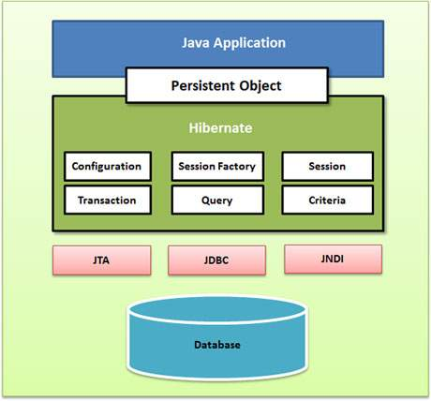
Hibernate Architecture

Slide 9
Hibernate Architecture
Session Factory: Manages configuration and creates Sessions
Session: Provides data access methods and interacts with persistent object
Persistent Objects: Java objects representing data stored in the database.
Transaction Management: Ensures data consistency and integrity.
Connection Provider: Handles database connections and pooling.
Query API: Supports HQL, Criteria API, and native SQL for flexible querying
Caching: Optimizes performance with first-level and second-level caches.
Event System: Allows customization of persistence lifecycle events.
Dialects: Generates database-specific SQL for portability.

Slide 10
Hibernate Architecture
SessionFactory
The SessionFactory is a factory of session and client of ConnectionProvider. It holds second level cache (optional) of data.
The org.hibernate.SessionFactory interface provides factory method to get the object of Session.
Session
The session object provides an interface between the application and data stored in the database. It is a short-lived object and wraps the JDBC connection. It is factory of Transaction, Query and Criteria. It holds a first-level cache (mandatory) of data.
The org.hibernate.Session interface provides methods to insert, update and delete the object. It also provides factory methods for Transaction, Query and Criteria.

Slide 11
Hibernate Architecture
Transaction
The transaction object specifies the atomic unit of work. It is optional. The org.hibernate.Transaction interface provides methods for transaction management.
ConnectionProvider
It is a factory of JDBC connections. It abstracts the application from DriverManager or DataSource. It is optional.
TransactionFactory
It is a factory of Transaction. It is optional.

Slide 12
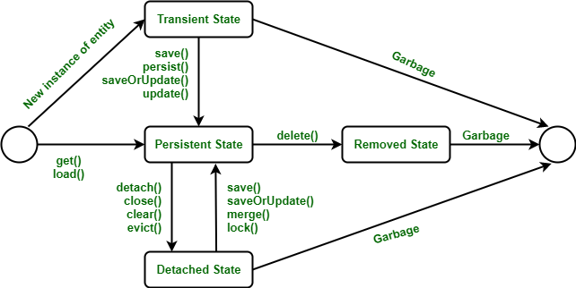
Hibernate Lifecycle

Slide 13
Hibernate Lifecycle
The Hibernate lifecycle refers to the various states an entity instance goes through during its interaction with the persistence framework. Understanding this lifecycle is crucial for effectively managing data and ensuring data integrity in your applications.
Understanding the Hibernate lifecycle is essential for writing efficient and reliable persistence code. By managing entity states and transitions effectively, you can ensure data integrity and optimize the performance of your applications.

Slide 14
Hibernate Lifecycle
1. Transient State
An entity instance is in a transient state when it's newly created using the new operator and not yet associated with a Hibernate session.
Changes made to a transient instance are not tracked by Hibernate and won't be persisted to the database.

Slide 15
Hibernate Lifecycle
2. Persistent State
An entity instance transitions to the persistent state when it's associated with a Hibernate session. This can happen through:
persist() method: Explicitly makes an instance persistent.
Cascading: If an associated entity is persisted and cascading is enabled, the current instance becomes persistent as well.
Querying: When an entity is retrieved from the database using find(), createQuery(), or other query methods.
Changes made to a persistent instance are tracked by Hibernate and will be synchronized with the database upon flushing or transaction commit.

Slide 16
Hibernate Lifecycle
3. Detached State
An entity instance becomes detached when it's no longer associated with a Hibernate session. This can occur when:
Session is closed: Closing the session detaches all persistent instances associated with it.
detach() method: Explicitly detaches an instance from the session.
Serialization: Serializing a persistent instance detaches it.
Changes made to a detached instance are not tracked by Hibernate and won't be automatically persisted.

Slide 17
Hibernate Lifecycle
4. Removed State
An entity instance enters the removed state when it's marked for deletion using the remove() method.
The actual deletion from the database occurs upon flushing or transaction commit.

Slide 18
JPA vs Hibernate
JPA | Hibernate
Java Persistence API (JP.A) defines the management of relational data in the Java applications. | Hibernate is an Object-Relational Mapping (ORM) tool which is used to save the state of Java object into the database.
It is just a specification. Various ORM tools implement it for data persistence. | It is one of the most frequently used JPA implementation.
It is defined in javax.persistence package. | It is defined in org.hibernate package.
The EntityManagerFactory interface is used to interact with the entity manager factory for the persistence unit. Thus, it provides an entity manager. | It uses SessionFactory interface to create Session instances.
It uses EntityManager interface to create, read, and delete operations for instances of mapped entity classes. This interface interacts with the persistence context. | It uses Session interface to create, read, and delete operations for instances of mapped entity classes. It behaves as a runtime interface between a Java application and Hibernate.
It uses Java Persistence Query Language (JPQL) as an object-oriented query language to perform database operations. | It uses Hibernate Query Language (HQL) as an object-oriented query language to perform database operations.

Slide 19
Hibernate Configuration
As Hibernate can operate in different environments, it requires a wide range of configuration parameters. These configurations contain the mapping information that provides different functionalities to Java classes. Generally, we provide database related mappings in the configuration file. Hibernate facilitates to provide the configurations either in an XML file (like hibernate.cfg.xml) or properties file (like hibernate.properties).
An instance of Configuration class allows specifying properties and mappings to applications. This class also builds an immutable SessionFactory.

Slide 20
Properties of Hibernate Configuration
Hibernate JDBC Properties
Property | Description
hibernate.connection.driver_class | It represents the JDBC driver class.
hibernate.connection.url | It represents the JDBC URL.
hibernate.connection.username | It represents the database username.
hibernate.connection.password | It represents the database password.
Hibernate.connection.pool_size | It represents the maximum number of connections available in the connection pool.

Slide 21
Properties of Hibernate Configuration
Hibernate Datasource Properties
Property | Description
hibernate.connection.datasource | It represents datasource JNDI name which is used by Hibernate for database properties.
hibernate.jndi.url | It is optional. It represents the URL of the JNDI provider.
hibernate.jndi.class | It is optional. It represents the class of the JNDI InitialContextFactory.

Slide 22
Properties of Hibernate Configuration
Property | Description
hibernate.dialect | It represents the type of database used in hibernate to generate SQL statements for a particular relational database.
hibernate.show_sql | It is used to display the executed SQL statements to console.
hibernate.format_sql | It is used to print the SQL in the log and console.
hibernate.default_catalog | It qualifies unqualified table names with the given catalog in generated SQL.
hibernate.default_schema | It qualifies unqualified table names with the given schema in generated SQL.
hibernate.session_factory_name | The SessionFactory interface automatically bound to this name in JNDI after it has been created.

Slide 23
Properties of Hibernate Configuration
Property | Description
hibernate.default_entity_mode | It sets a default mode for entity representation for all sessions opened from this SessionFactory
hibernate.order_updates | It orders SQL updates on the basis of the updated primary key.
hibernate.use_identifier_rollback | If enabled, the generated identifier properties will be reset to default values when objects are deleted.
hibernate.generate_statistics | If enabled, the Hibernate will collect statistics useful for performance tuning.
hibernate.use_sql_comments | If enabled, the Hibernate generate comments inside the SQL. It is used to make debugging easier.

Slide 24
Hibernate Cache Properties
Property | Description
hibernate.cache.provider_class | It represents the classname of a custom CacheProvider.
hibernate.cache.use_minimal_puts | It is used to optimize the second-level cache. It minimizes writes, at the cost of more frequent reads.
hibernate.cache.use_query_cache | It is used to enable the query cache.
hibernate.cache.use_second_level_cache | It is used to disable the second-level cache, which is enabled by default for classes which specify a mapping.
hibernate.cache.query_cache_factory | It represents the classname of a custom QueryCache interface.
hibernate.cache.region_prefix | It specifies the prefix which is used for second-level cache region names.
hibernate.cache.use_structured_entries | It facilitates Hibernate to store data in the second-level cache in a more human-friendly format.

Slide 25
Properties of Hibernate Configuration
Hibernate Transaction Properties
Property | Description
hibernate.transaction.factory_class | It represents the classname of a TransactionFactory which is used with Hibernate Transaction API.
hibernate.transaction.manager_lookup_class | It represents the classname of a TransactionManagerLookup. It is required when JVM-level caching is enabled.
hibernate.transaction.flush_before_completion | If it is enabled, the session will be automatically flushed during the before completion phase of the transaction.
hibernate.transaction.auto_close_session | If it is enabled, the session will be automatically closed during the after completion phase of the transaction.

Slide 26
Properties of Hibernate Configuration
Other Hibernate Properties
Property | Description
hibernate.connection.provider_class | It represents the classname of a custom ConnectionProvider which provides JDBC connections to Hibernate.
hibernate.connection.isolation | It is used to set the JDBC transaction isolation level.
hibernate.connection.autocommit | It enables auto-commit for JDBC pooled connections. However, it is not recommended.
hibernate.connection.release_mode | It specifies when Hibernate should release JDBC connections.
hibernate.current_session_context_class | It provides a custom strategy for the scoping of the "current" Session.
hibernate.hbm2ddl.auto | It automatically generates a schema in the database with the creation of SessionFactory.

Slide 27
Annotations in Hibernate

Slide 28
Commonly Used Annotations
@Entity: Marks a class as a persistent entity, indicating that it represents data stored in a database table.
@Table: Specifies the name of the database table to which the entity is mapped.
@Id: Identifies the primary key property of the entity.
@GeneratedValue: Configures the strategy for generating identifier values (e.g., AUTO, SEQUENCE, IDENTITY).
@Column: Provides details about the mapping of a property to a database column, such as the column name, data type, and nullability.

Slide 29
Commonly Used Annotations
@Basic: Marks a property as a basic type (e.g., String, int, Date).
@Transient: Excludes a property from persistence.
@Embedded: Map embeddable components as value types.
@Temporal: Specifies the temporal precision of a date/time property.
@Enumerated: Configures the mapping of an enum type.
@Lob: Marks a property as a large object (BLOB or CLOB).
@Version: Enables optimistic locking with a version property.
@CreationTimestamp, @UpdateTimestamp: Automatically set timestamps for creation and update events.

Slide 30
Relationships Annotations in Hibernate
@ManyToOne: This annotation defines a many-to-one relationship between two entities.
@OneToMany: This annotation defines a one-to-many relationship between two entities.
@OneToOne: This annotation defines a one-to-one relationship between two entities.
@ManyToMany: This annotation defines a many-to-many relationship between two entities.

Slide 31
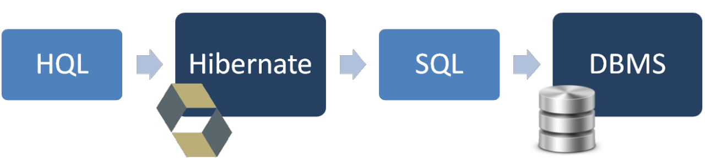
Hibernate Query Language (HQL)
Hibernate Query Language (HQL) is same as SQL (Structured Query Language) but it doesn't depends on the table of the database. Instead of table name, we use class name in HQL. So it is database independent query language.

Slide 32
Advantage of HQL
Database independent
Supports polymorphic queries
Easy to learn for Java Programmer

Slide 33
Query Interface
It is an object oriented representation of Hibernate Query. The object of Query can be obtained by calling the createQuery() method Session interface.
public int executeUpdate() is used to execute the update or delete query.
public List list() returns the result of the ralation as a list.
public Query setFirstResult(int rowno) specifies the row number from where record will be retrieved.

Slide 34
Query Interface
public Query setMaxResult(int rowno) specifies the no. of records to be retrieved from the relation (table).
public Query setParameter(int position, Object value) it sets the value to the JDBC style query parameter.
public Query setParameter(String name, Object value) it sets the value to a named query parameter.

Slide 35
Example of HQL paging
Query query=session.createQuery("from Student");
query.setFirstResult(5);
query.setMaxResult(10);
List list=query.list();//will return the records from 5 to 10th number

Slide 36
Example of HQL update query
Transaction tx=session.beginTransaction();
Query q=session.createQuery("update Student set lastName=:n where id=:i");
q.setParameter("n",“Sang");
q.setParameter("i",1);
int status=q.executeUpdate();
System.out.println(status);
tx.commit();

Slide 37
Demo Hibernate (One To Many)

Slide 38
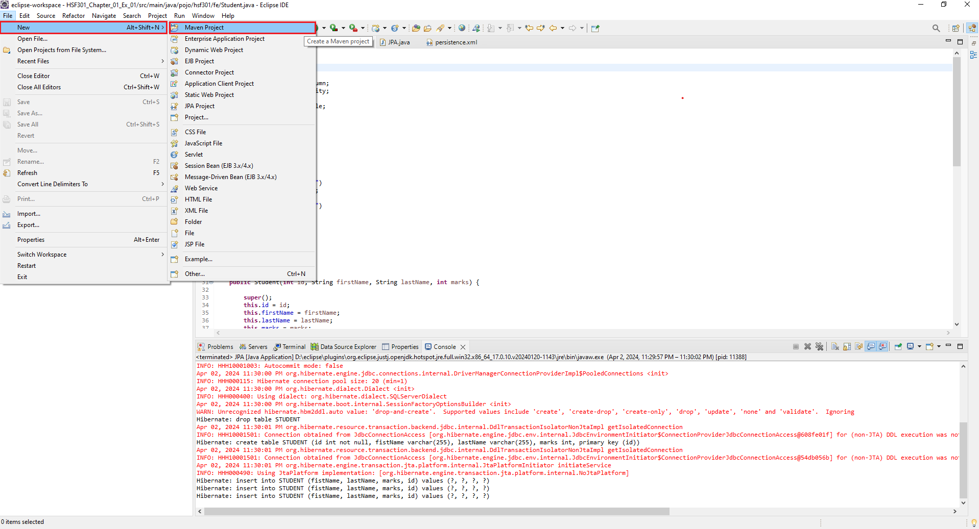
1. Open Eclipse, File | New | Maven Project

Slide 39
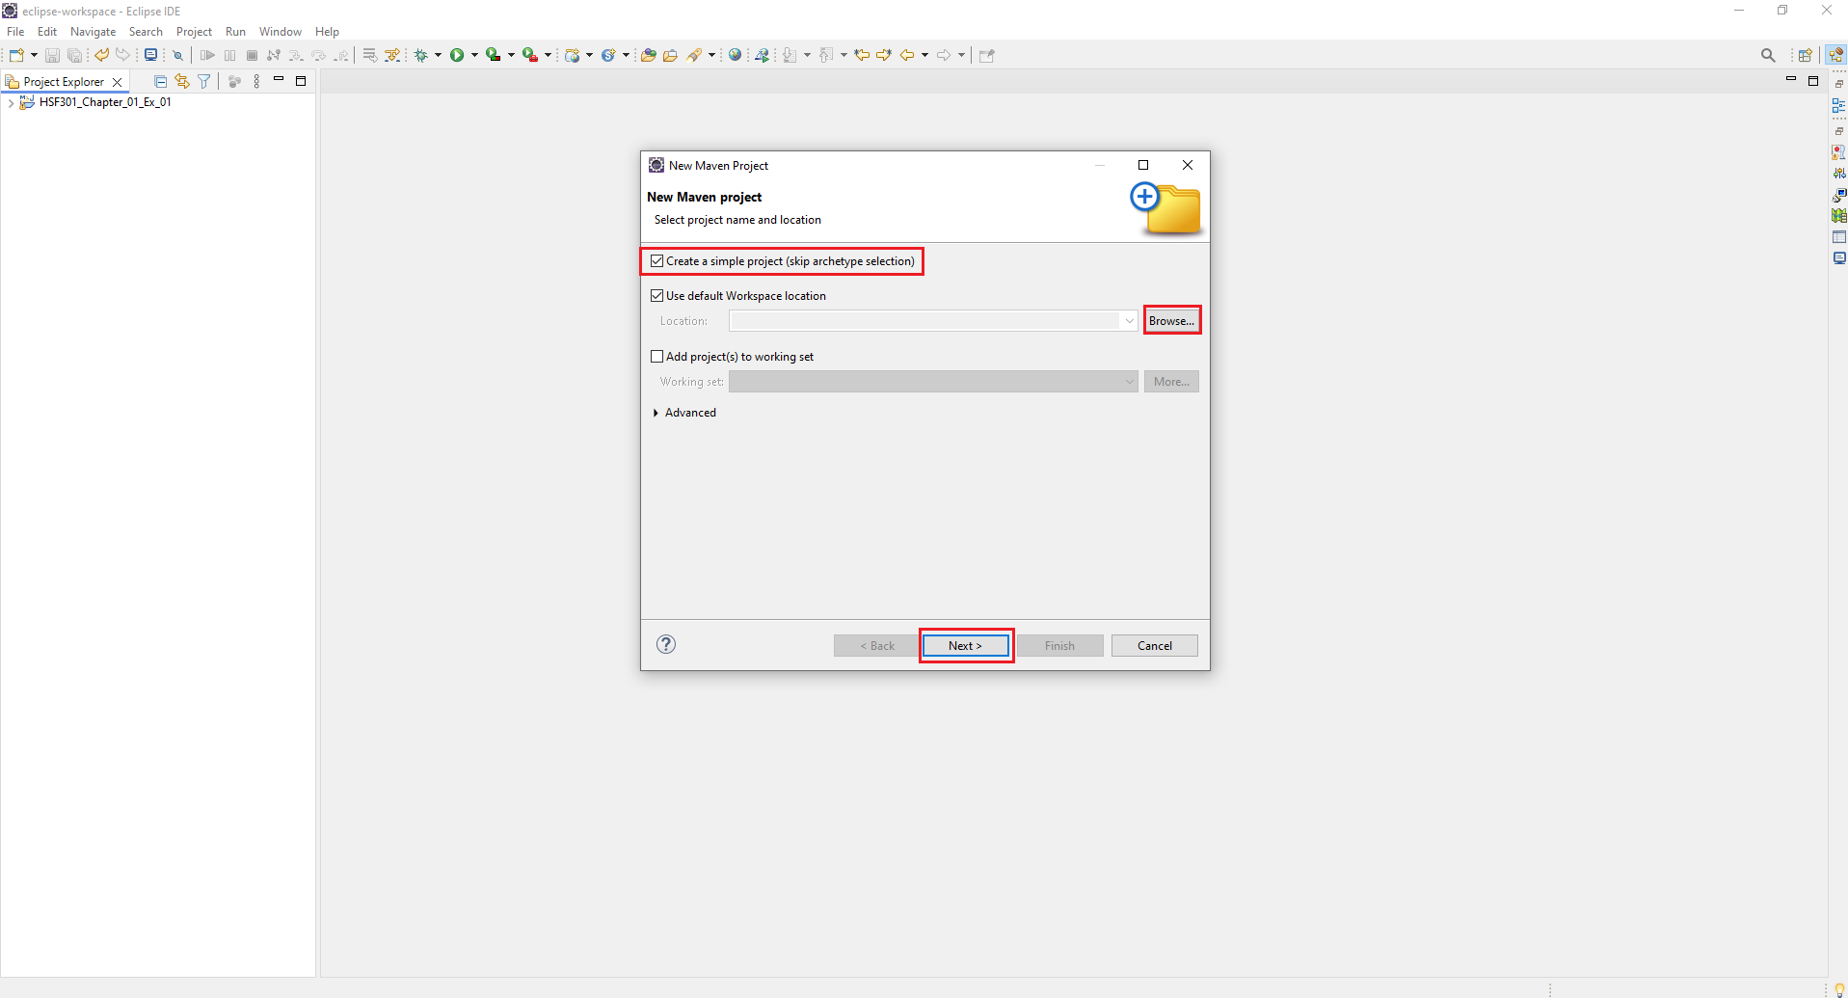
2. Check Create a simple project -> Browse Project -> Next

Slide 40
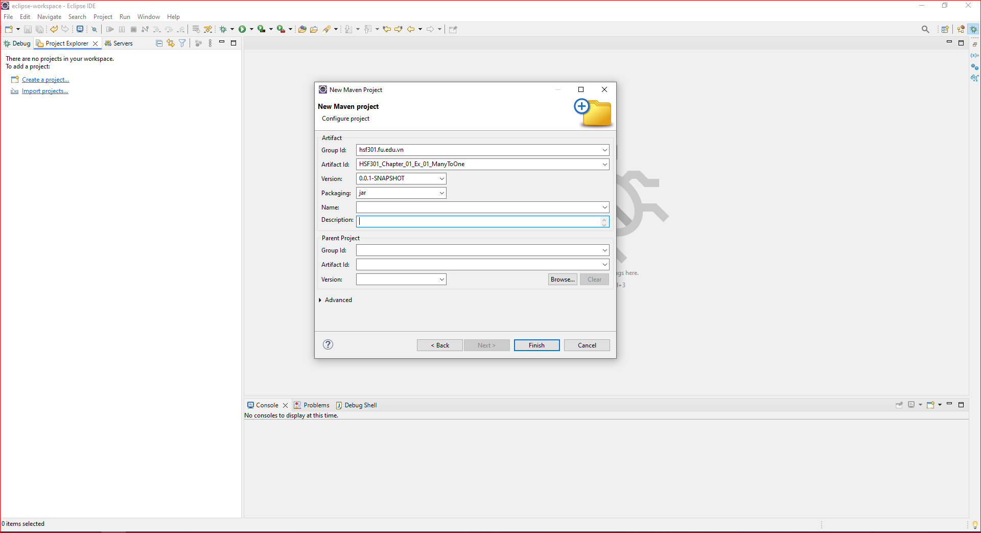
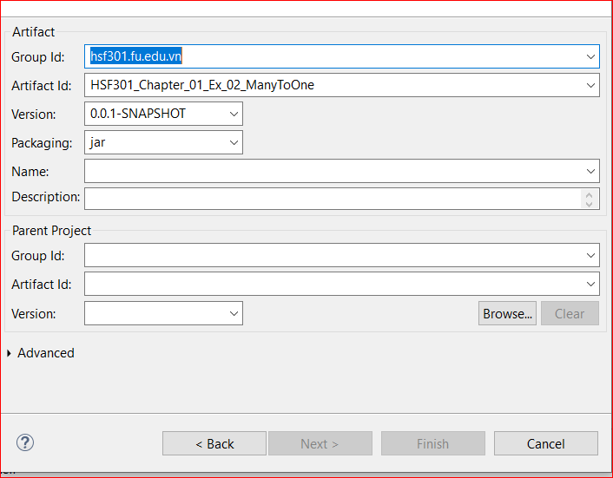
3. Fill the information Project -> Click Finish

Slide 41
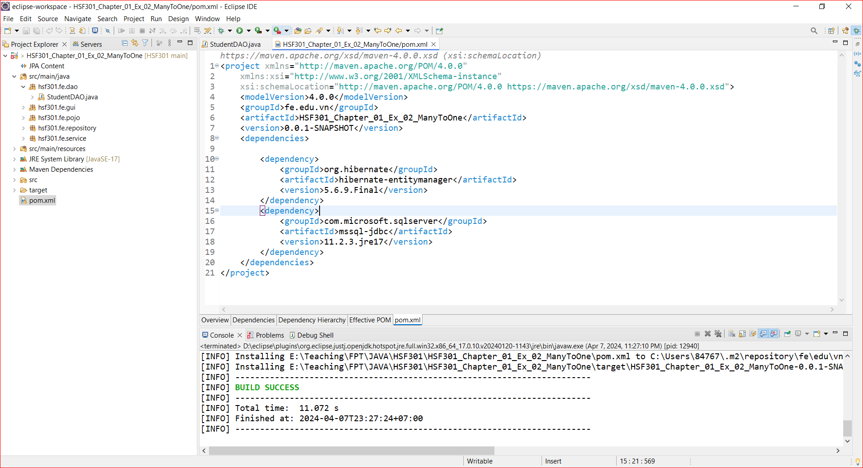
4. Structure of Maven Project

Slide 42
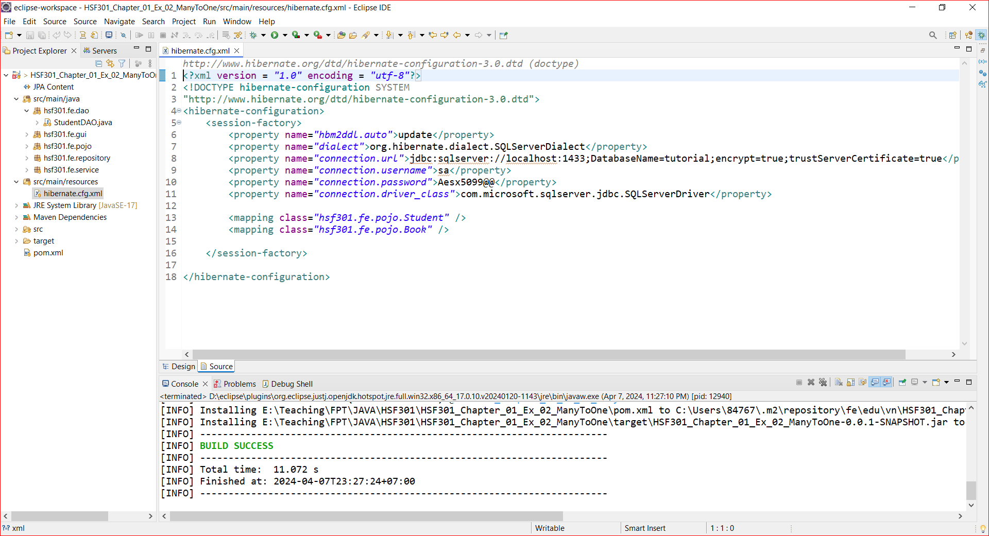
5. Create hibernate.cfg.xml

Slide 43
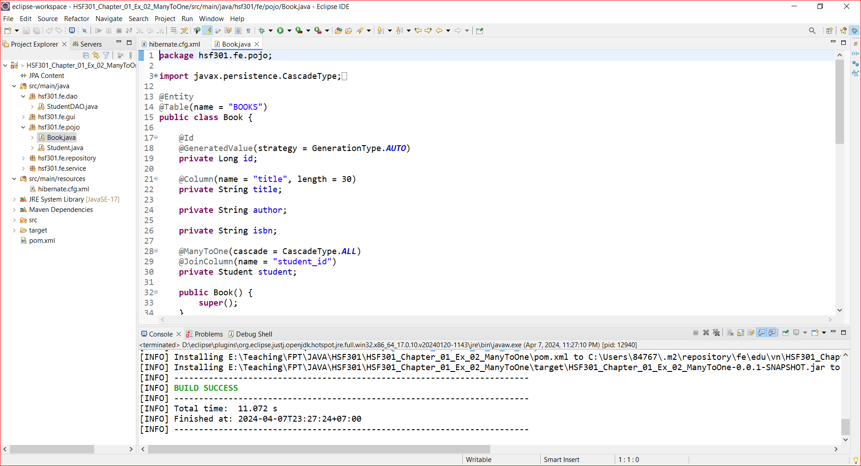
6. Create Books in Pojo

Slide 44
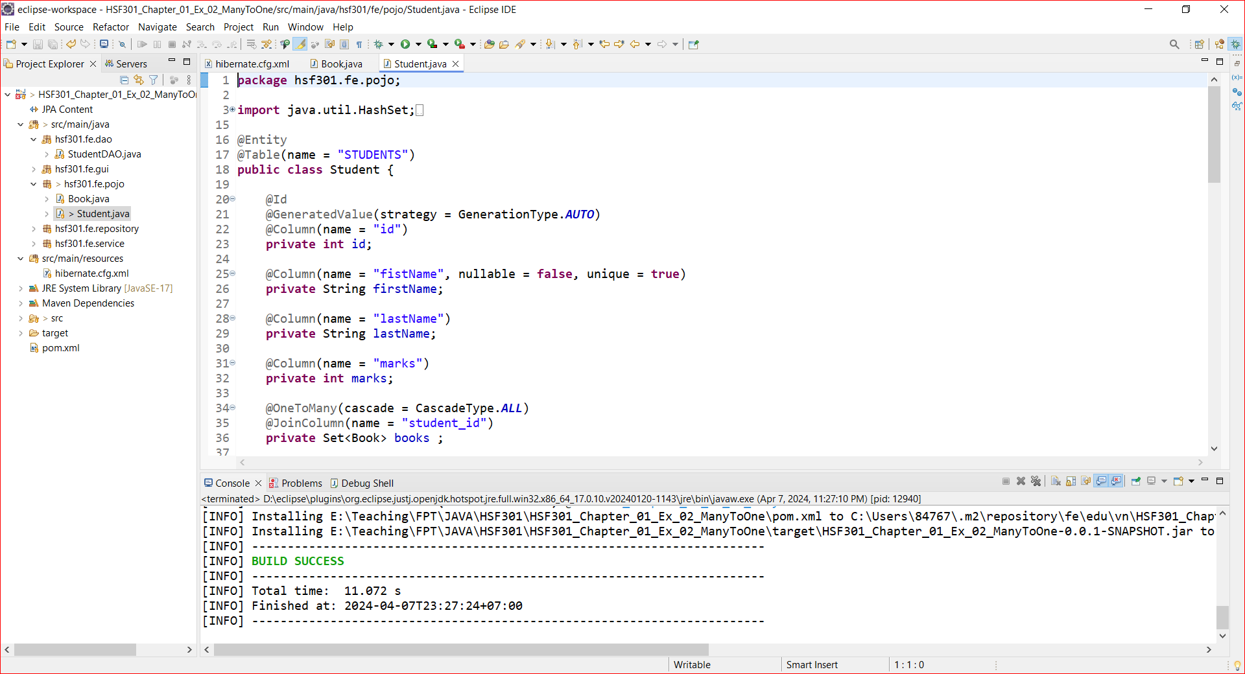
7. Create Students in Pojo

Slide 45
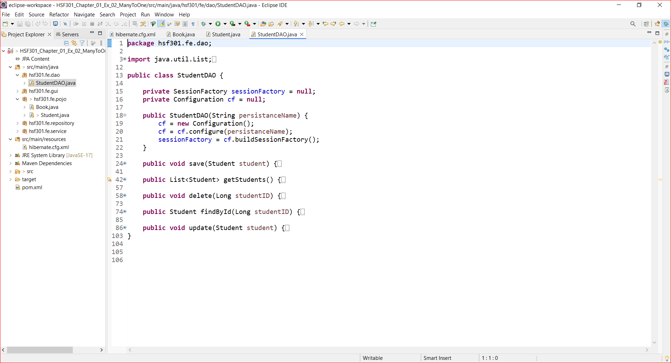
8. Create StudentDAO

Slide 46
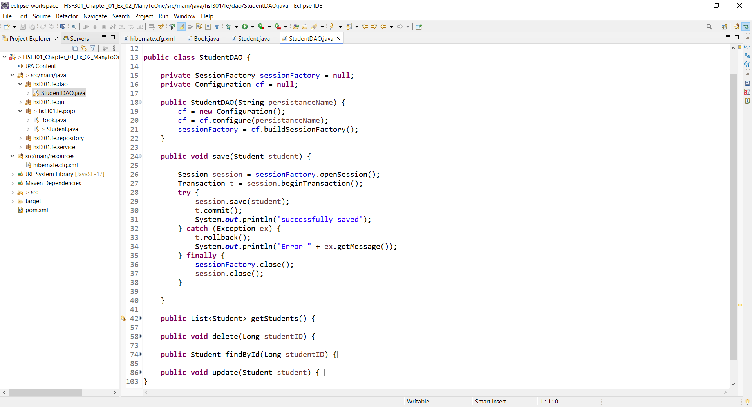
9. Save Student in StudentDAO

Slide 47
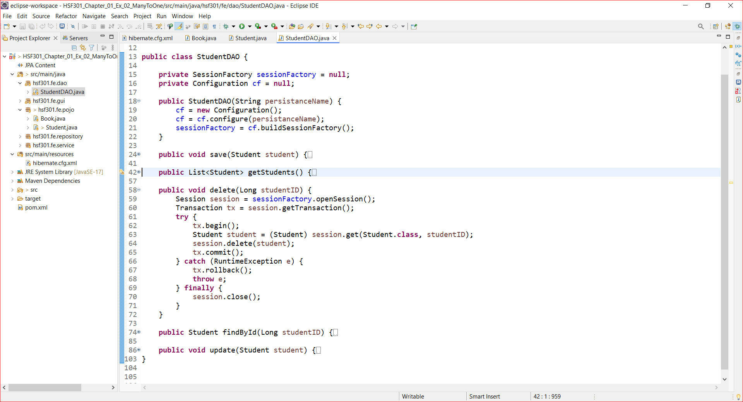
10. Get All Student in StudentDAO

Slide 48

11. Delete Student in StudentDAO

Slide 49
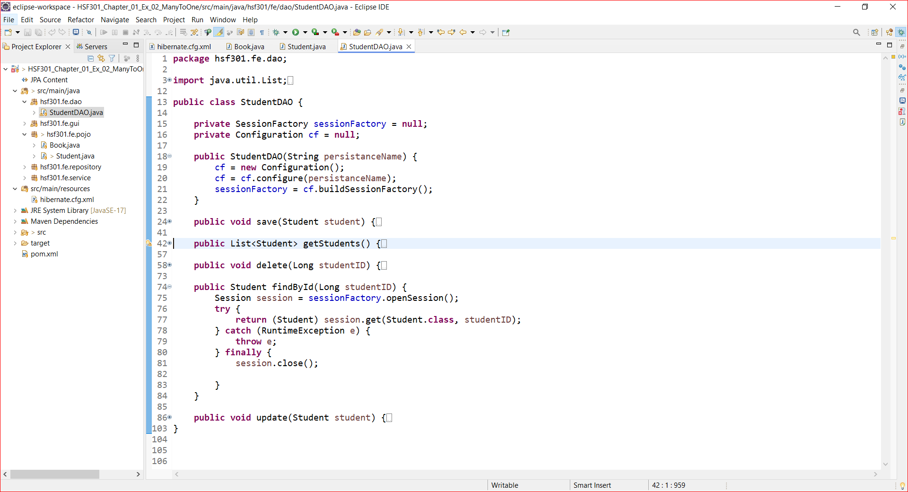
12. Find A Student in StudentDAO

Slide 50
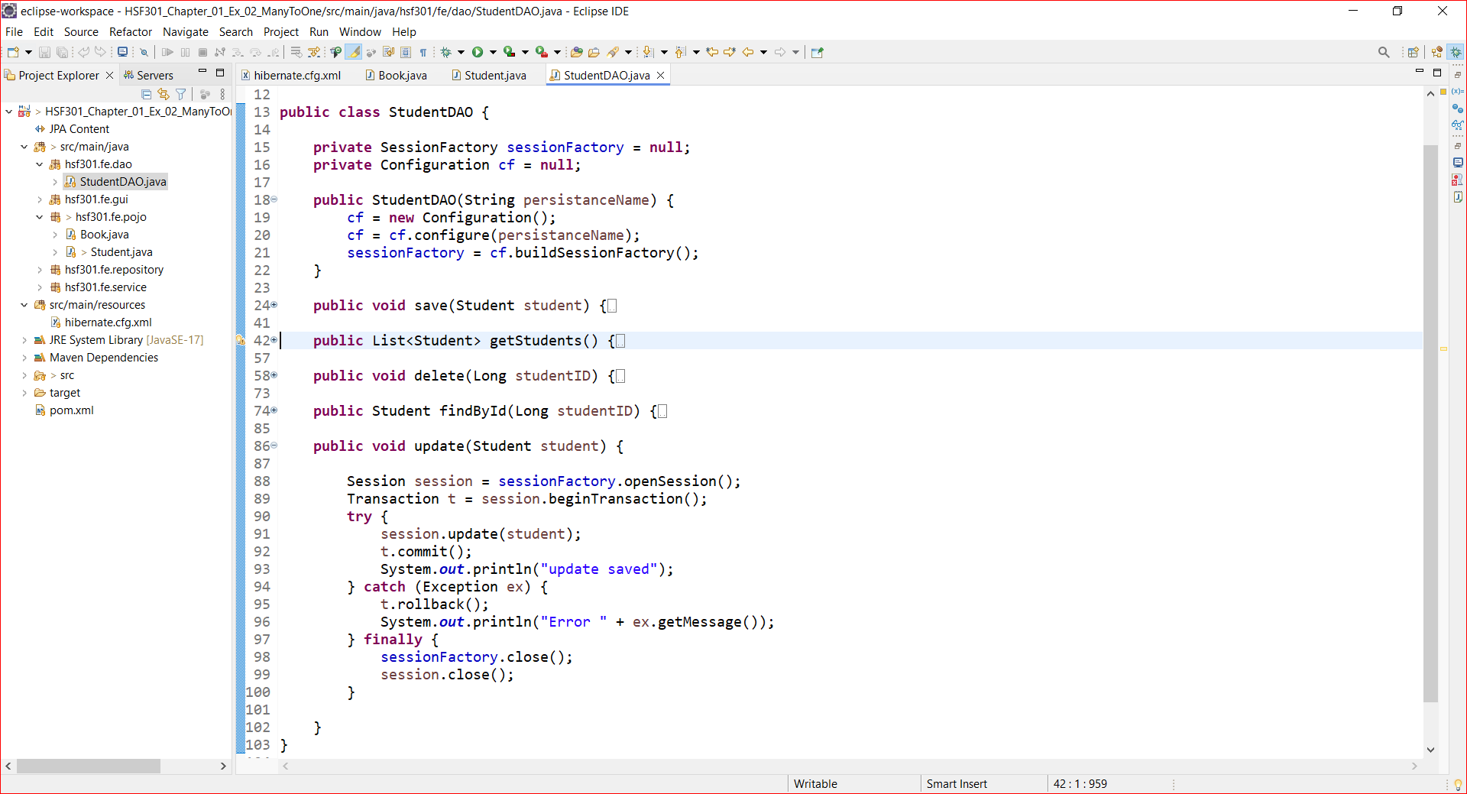
13. Update a Student in StudentDAO

Slide 51
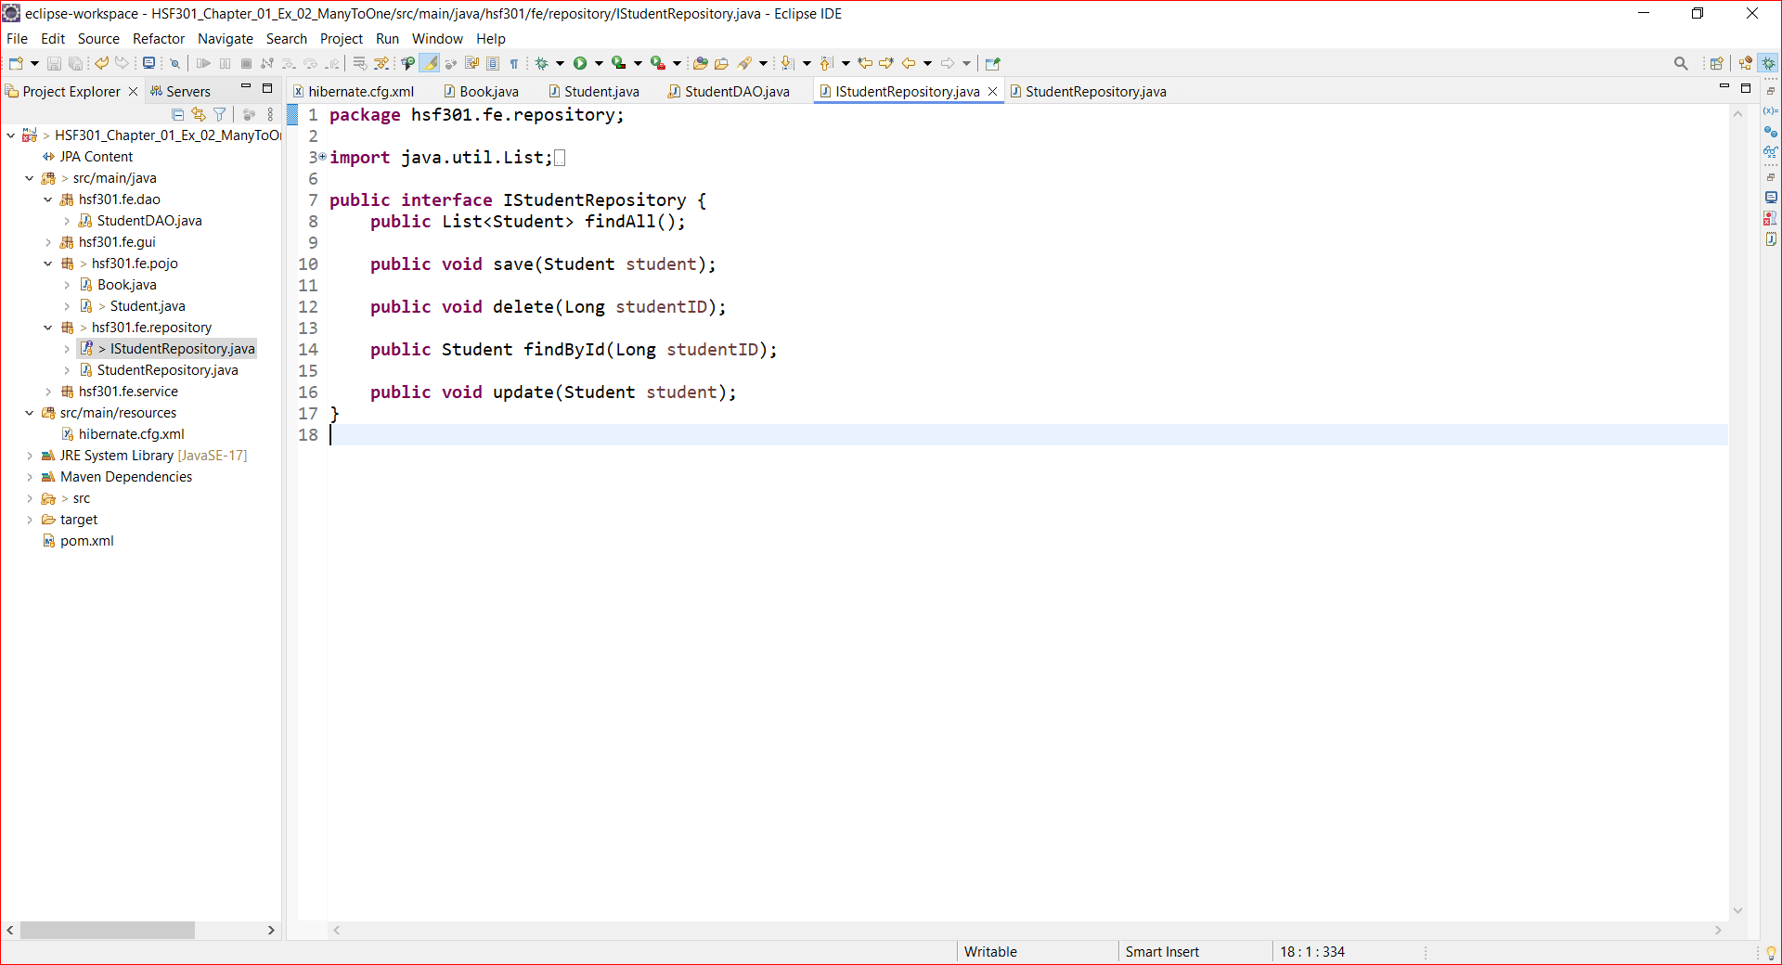
14. Create IStudentRepository

Slide 52
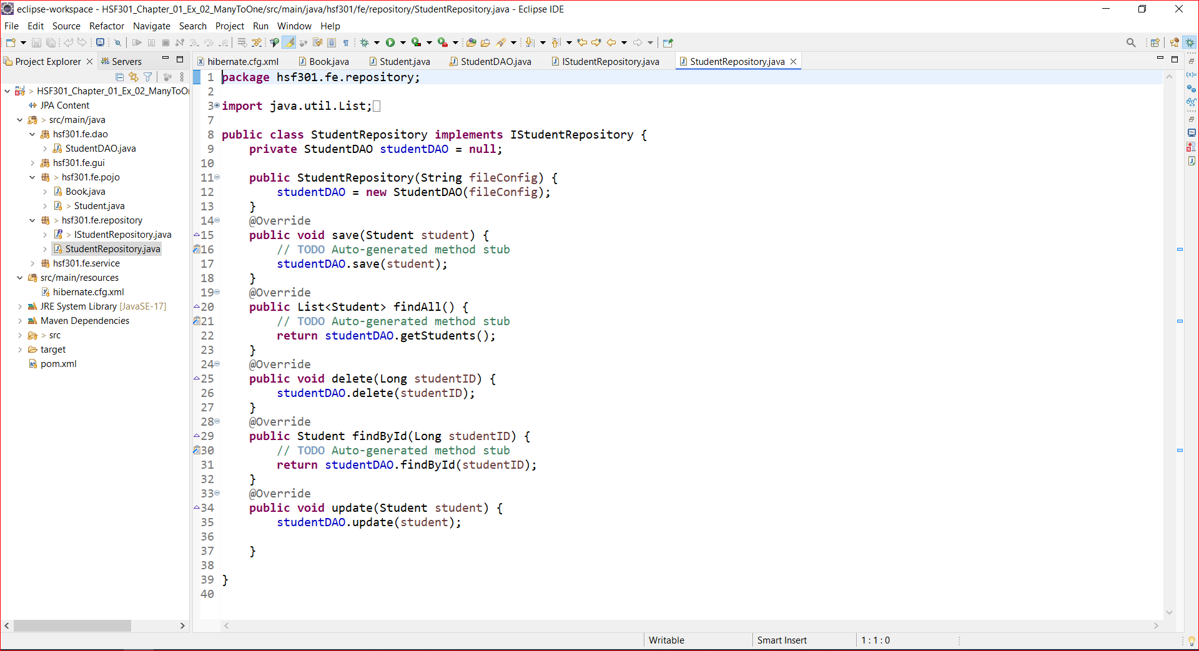
15. Create StudentRepository

Slide 53
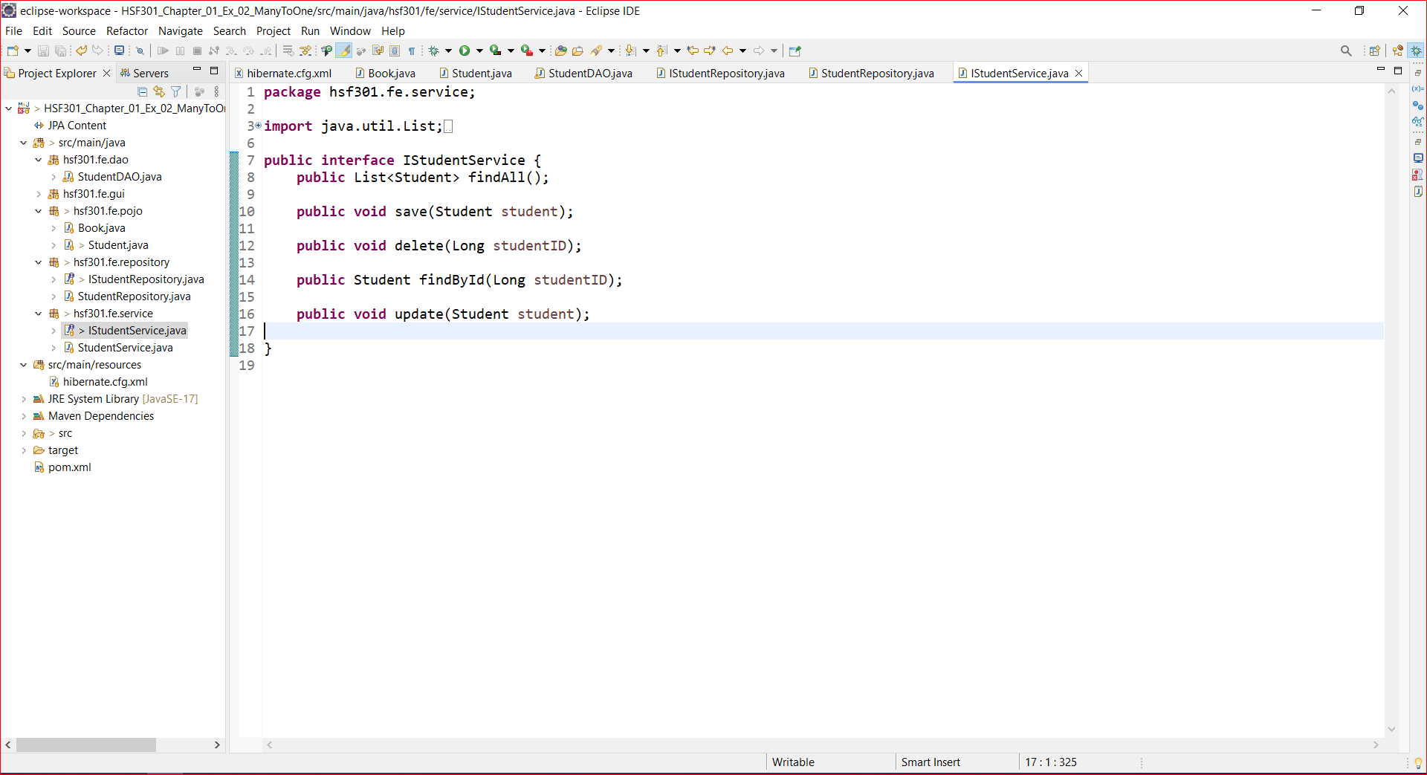
16. Create IStudentService

Slide 54
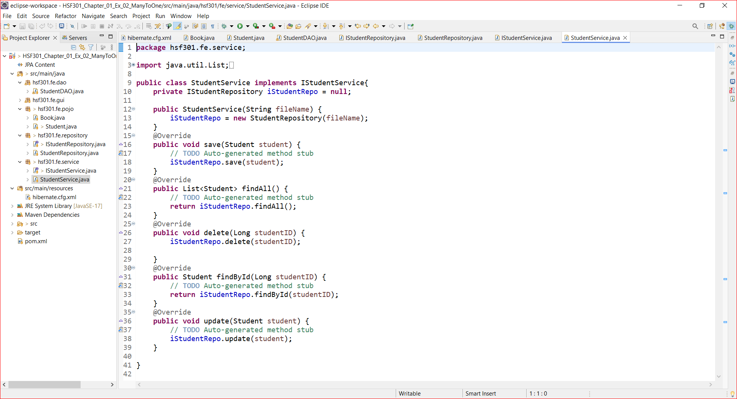
17. Create StudentService

Slide 55
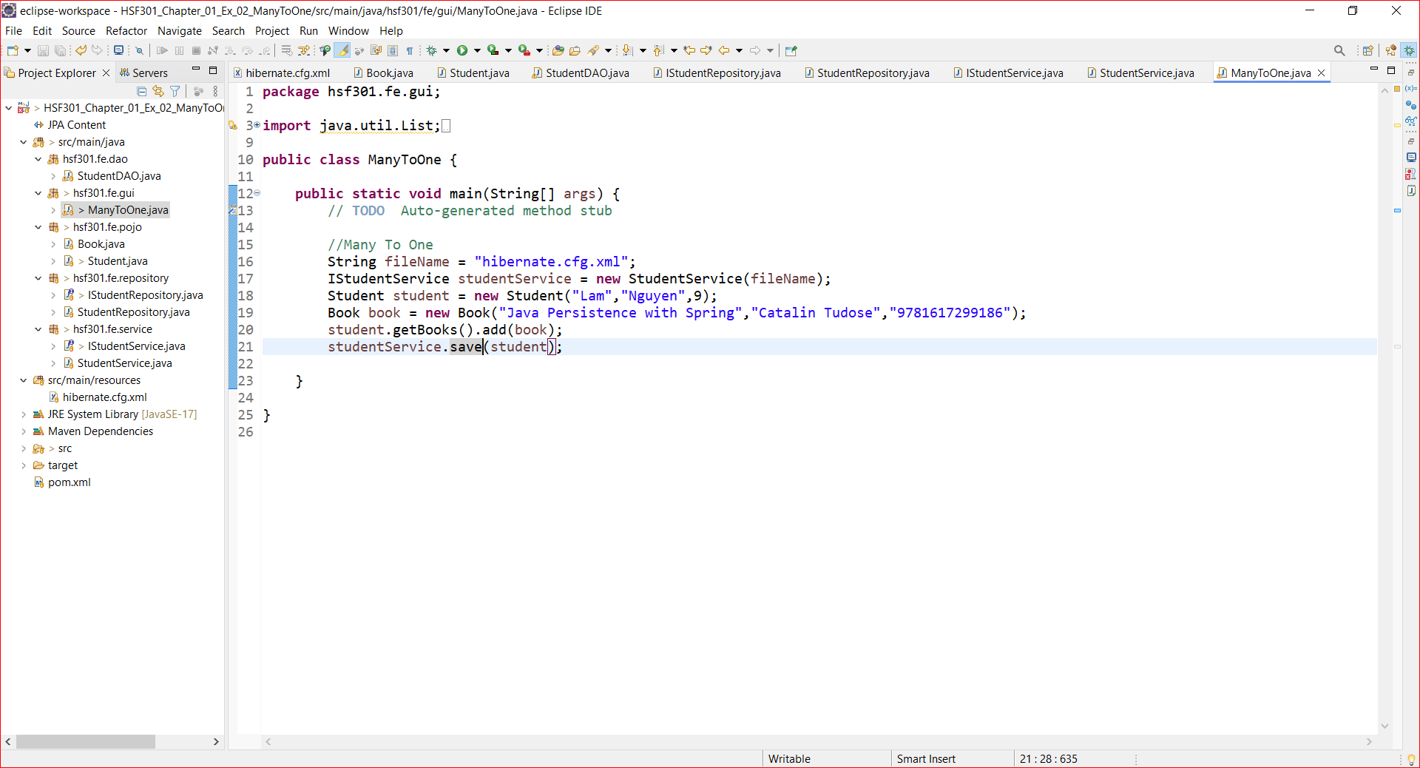
18. Create Main function

Slide 56
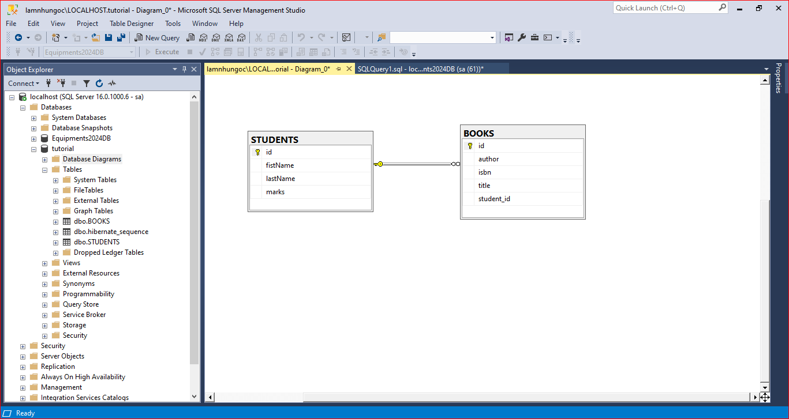
19. Result

Slide 57
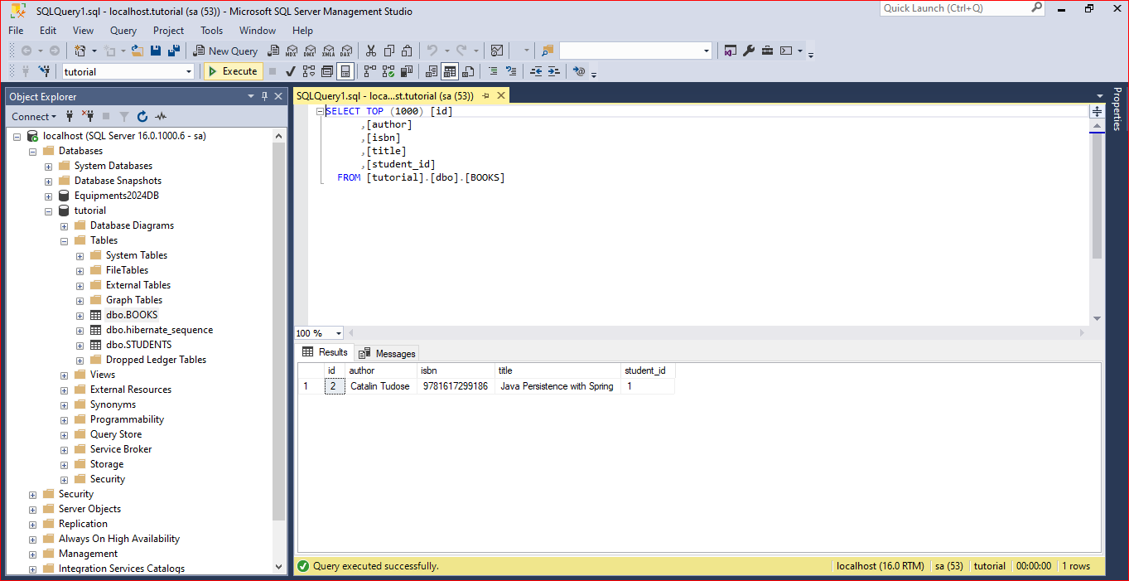
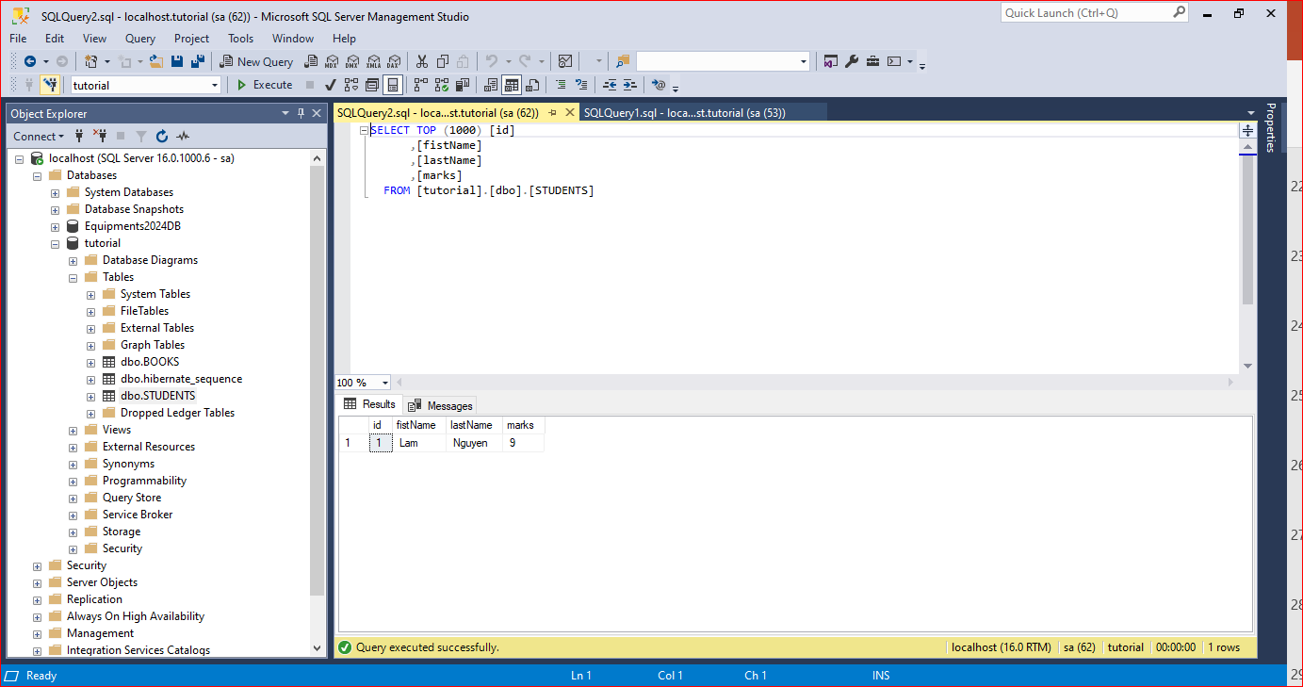
20. Result

Slide 58
Demo JPA (Many To Many)

Slide 59
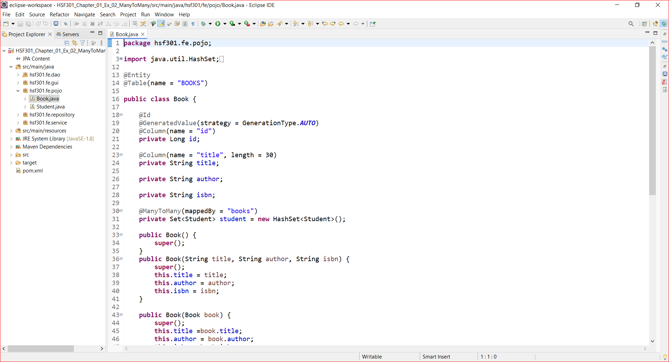
1. Create Books in Pojo’s Package

Slide 60
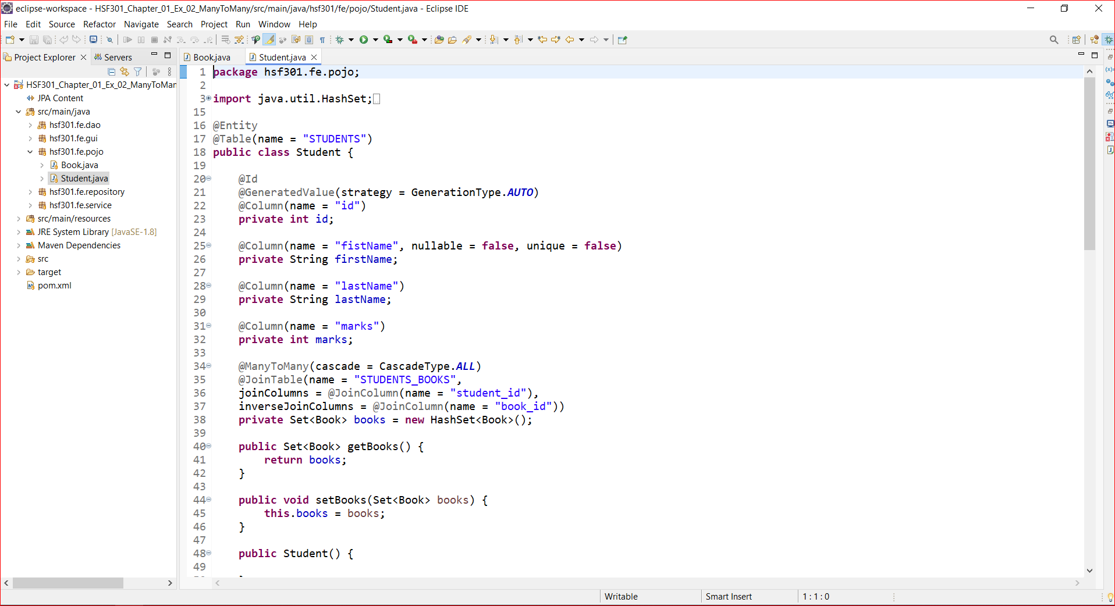
2. Create Students in Pojo’s Package

Slide 61
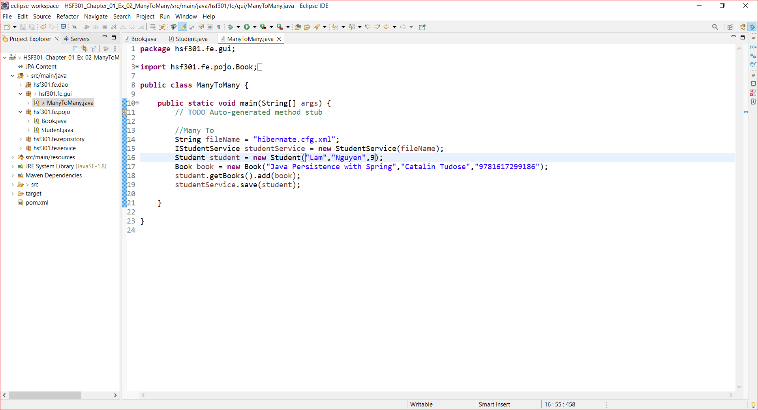
3. Run Program

Slide 62
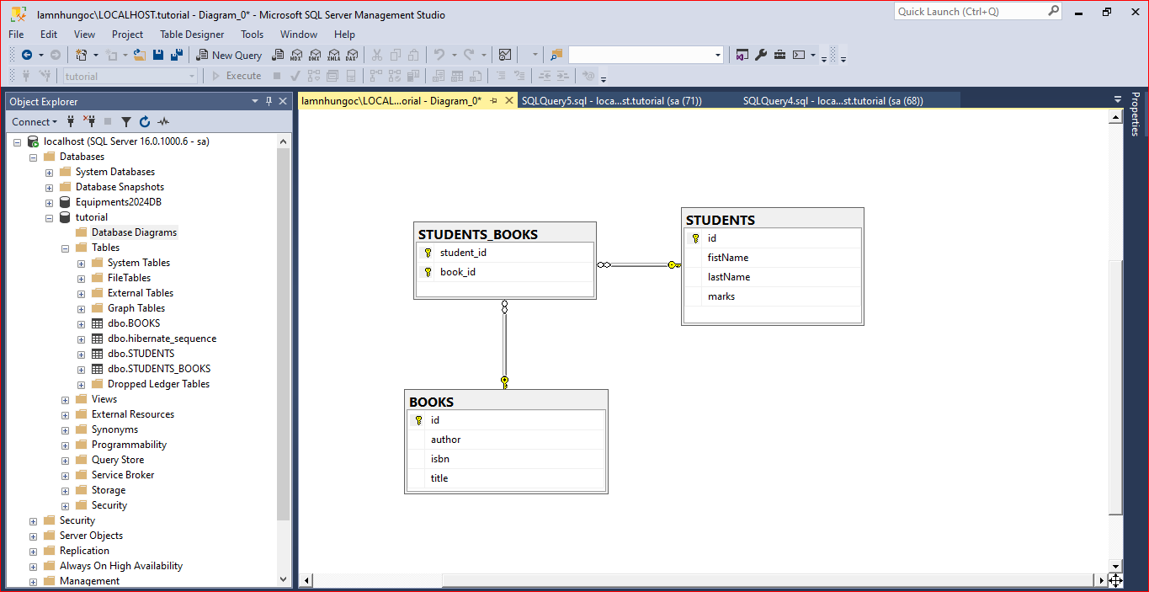
4. Result

Slide 63
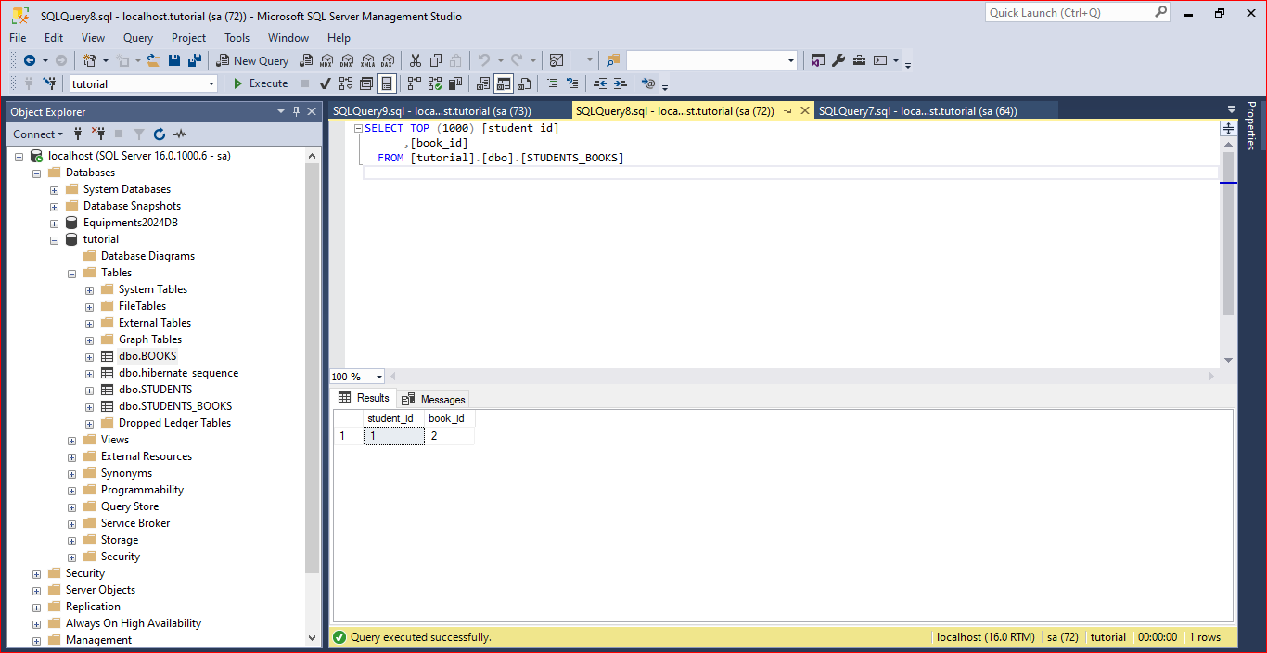
5. Result

Slide 64
Summary
Concepts were introduced:
Overview about Hibernate
Architecture Overview new features of Hibernate
Explain and demo using Eclipse IDE to create Hibernate Console
Create and Run cross-platform Console application with Java connect to MSSQL with Repository Pattern

